Slide 1


Predicting AQI Levels
Final Project Presentation – Applied Data Science DSC680-T303 (2253-1)
Joseph Damico
12/22/2024
Notes:
Hello everyone. My name is Joseph and today I’m presenting my project on predicting AQI using geographic and administrative features. In this project I will use PM2.5 to explain AQI. PM2.5 is a significant air pollutant with adverse health effects and this project explores how we can predict its levels using data-driven techniques.

Slide 2
Business Problem
PM2.5 poses significant health risks, including respiratory and cardiovascular diseases.
Geographic and administrative data can support proactive monitoring and prediction.
The goal is to predict PM2.5 levels to inform mitigation strategies.
Notes:
PM2.5 poses serious health risks particularly to the respiratory and cardiovascular systems. It’s essential to predict these levels to enable proactive measures for pollution mitigation. By leveraging geographic and administrative data this project aims to create a predictive model that helps the public identify areas at risk and plan interventions effectively.

Slide 3
Background/History
PM2.5 are fine particles smaller than 2.5 micrometers.
Sources: urbanization, industrial activities, and natural events.
Health impacts: penetrates deeply into lungs, causing severe health risks.
Monitoring programs like EPA track and regulate PM2.5 levels.
Notes:
PM2.5 refers to fine particulate matter that is smaller than 2.5 micrometers in diameter. These particles are small enough to penetrate deep into the lungs causing health issues such as asthma, lung cancer, and cardiovascular problems. Common sources of PM2.5 include vehicle emissions, industrial activities, and natural events like wildfires. The Environmental Protection Agency monitors PM2.5 levels to ensure public safety.

Slide 4
Data Explanation
Dataset: EPA's PM2.5 monitoring data for 2022–2024.
550 records retained after filtering for advisory recommendations.
Key features: latitude, longitude, state/county codes, PM2.5 levels.
Notes:
For this project I used three years of monitoring data from the EPA, covering 2022 to 2024. After filtering and cleaning the data based on advisory recommendations from an accompanying pdf file, I retained 550 records. Key features included geographic coordinates, administrative details like state and county codes, and PM2.5 levels measured as the arithmetic mean.

Slide 5
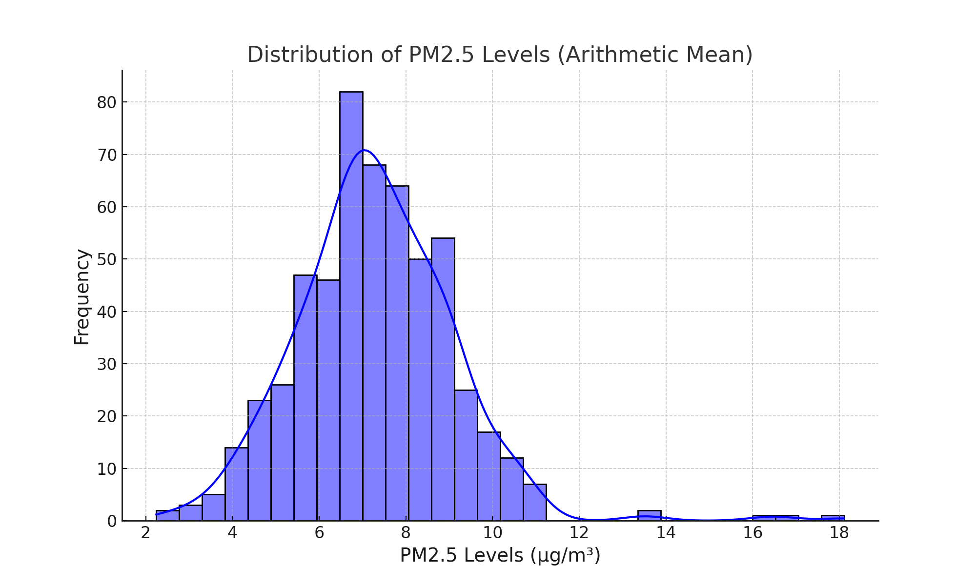
Distribution of PM2.5 Levels
Notes:
This histogram shows the distribution of PM2.5 levels across the dataset. Most levels are clustered around the mean, with occasional higher values indicating potential pollution spikes. This distribution provides a baseline for understanding PM2.5 variability.

Slide 6
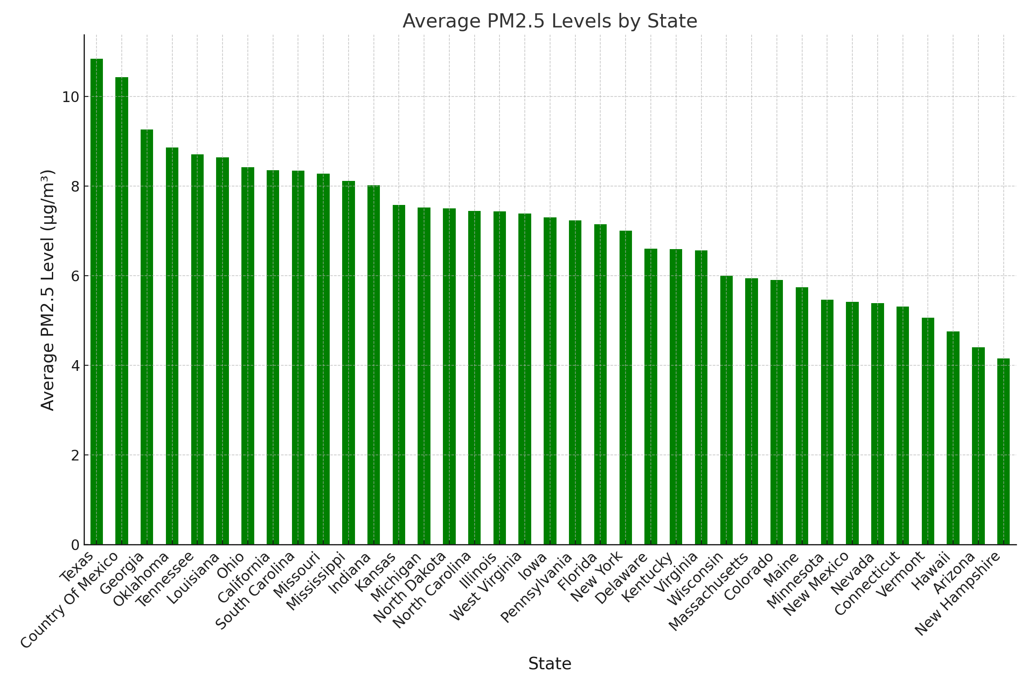
Average PM2.5 Levels by State
Notes:
This bar chart illustrates the average PM2.5 levels by state. States with higher averages are highlighted showing significant geographic differences in air quality. These findings emphasize the importance of targeted interventions in specific states.

Slide 7
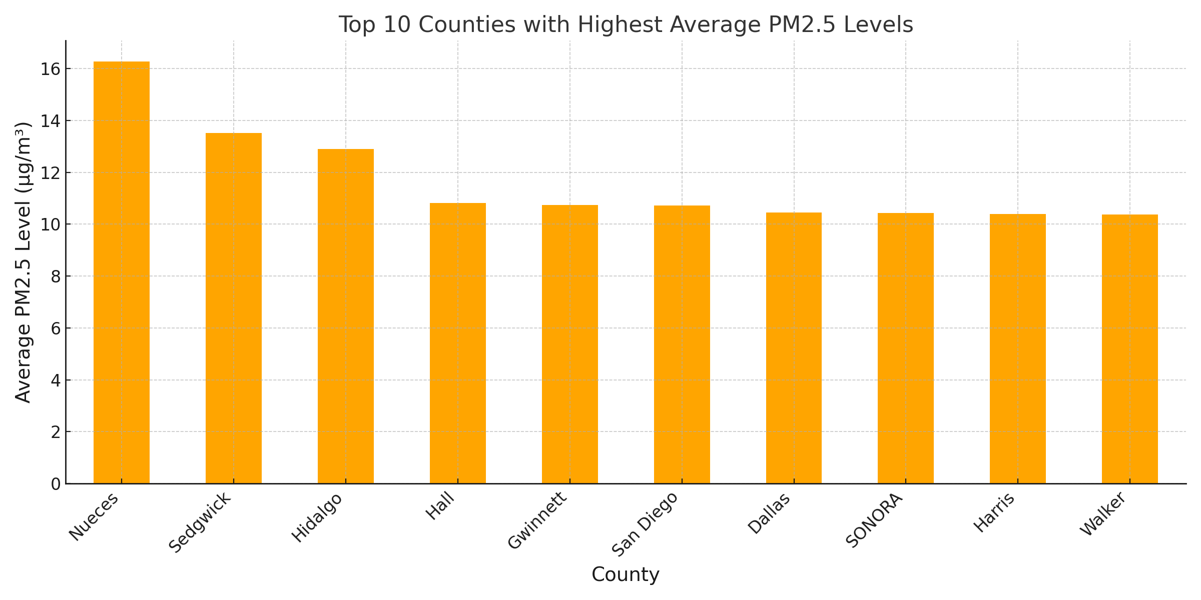
Top 10 Counties with Highest PM2.5 Levels
Notes:
This chart highlights the top 10 counties with the highest average PM2.5 levels. Counties with elevated pollution levels are a priority for mitigation efforts. By identifying these areas we can allocate resources more effectively.

Slide 8
Modeling Approach
Random Forest Regressor was used to predict PM2.5 levels.
Features: latitude, longitude, state and county codes.
Metrics: RMSE = 1.01, R² = 0.58.
Notes:
For the predictive modeling I used a Random Forest Regressor. This model leverages geographic and administrative features such as latitude, longitude, state code, and county code. The model’s performance metrics include a Root Mean Squared Error of 1.01 and an R-squared score of 0.58, indicating moderate predictive accuracy.

Slide 9
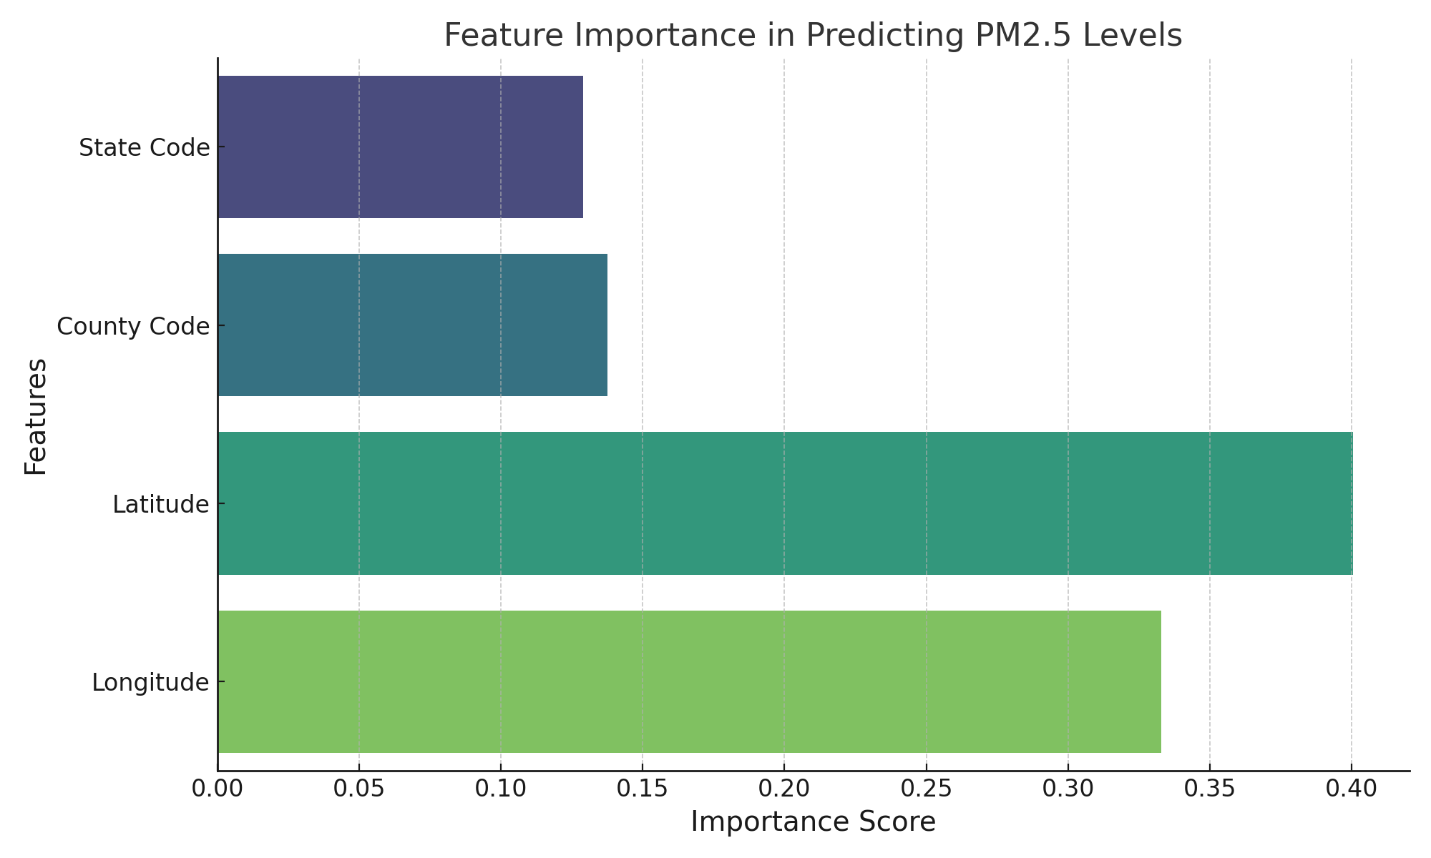
Feature Importance
Notes:
This bar chart shows the importance of each feature in predicting PM2.5 levels. Latitude and longitude are the most significant predictors underscoring the spatial variability of PM2.5. Administrative codes also contribute but to a lesser extent.

Slide 10
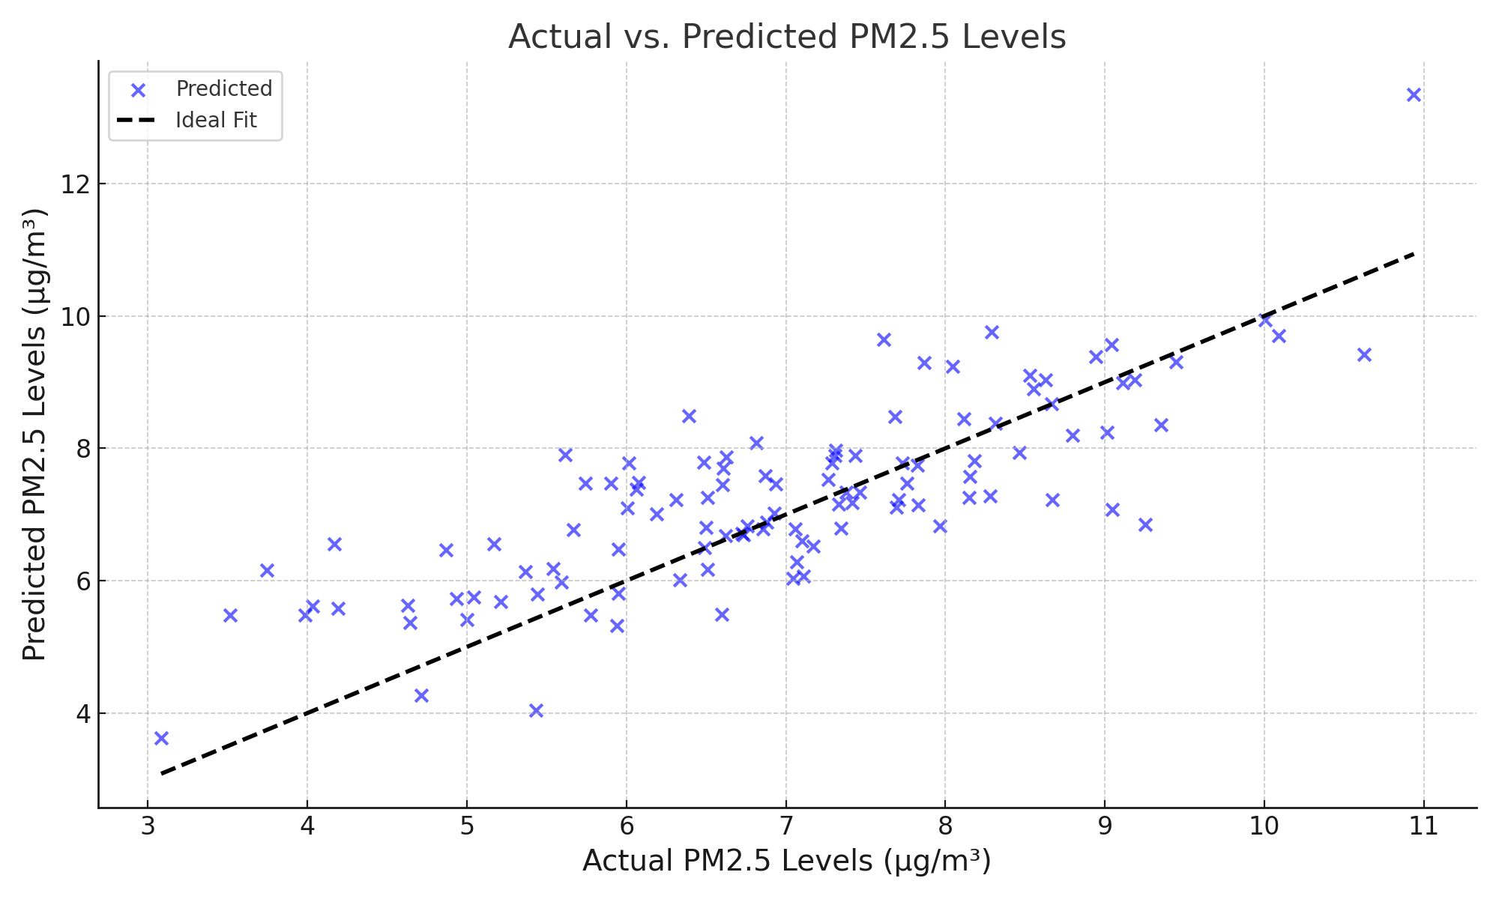
Actual vs Predicted PM2.5 Levels
Notes:
This scatter plot compares actual and predicted PM2.5 levels. The model predictions moderately align with the observed values, with some variability. This demonstrates the model’s potential for capturing trends while leaving room for improvement.

Slide 11
Challenges and Limitations
Challenges:
Filtering data required detailed manual verification.
Ensuring consistency across years.
Limitations:
Model explains 58% of variance.
Sudden events like wildfires are not included.
Notes:
There were a few challenges and limitations in this project. Filtering the dataset required detailed manual verification of method names based on EPA recommendations. The model explains 58% of the variance in PM2.5 levels and additional features like meteorological data could improve accuracy. Sudden pollution events such as wildfires were not included in the analysis.

Slide 12
Recommendations
Incorporate additional features like meteorological and industrial data.
Extend analysis to include real-time applications.
Develop public dashboards for immediate data use.
Notes:
I recommend incorporating additional features such as industrial emissions, meteorological variables, and traffic patterns, to improve prediction accuracy. Extending the model to include real-time data streams can also enhance its applicability. Finally developing public dashboards can make these predictions accessible for immediate use.

Slide 13

Conclusion
Geographic and administrative data are crucial for PM2.5 predictions.
The project demonstrates moderate predictive accuracy.
Future improvements can enhance applicability for public health.
Notes:
In conclusion, this project demonstrates the feasibility of predicting PM2.5 levels using geographic and administrative features. While the model achieved moderate accuracy it highlights the critical role of spatial variability in air quality. With further enhancements this approach can contribute significantly to public health and environmental planning.

